Slide 1
UI Design Process & Personas
CSE463
Dr. Atkinson
1.30.17

Slide 2
The User Interface
User interfaces should be designed to match the skills, experience and expectations of its anticipated users.
System users often judge a system by its interface rather than its functionality.
A poorly designed interface can cause a user to make catastrophic errors.
Poor user interface design is the reason why so many software systems are never used.

Slide 3
The UI Design Process
UI design is an iterative process involving close liaisons between users and designers.
The 3 core activities in this process are:
User analysis. Understand what the users will do with the system;
System prototyping. Develop a series of prototypes for experiment;
Interface evaluation. Experiment with these prototypes with users.

Slide 4
The UI Design Process

Slide 5
Design Guidelines: Use Parallel Design
Have several developers independently propose designs and use the best elements from each design
Attempt to “saturate the design space” before selecting ideal solution
Generally, the more varied and impendent the ideas that are considered, the better the final product will be.

Slide 6
Design Guideline: Set Usability Goals
Performance goals that include success rates and time it takes user to complete task
Helps guide prototype development and usability testing

Slide 7
Design Guideline: Use Personas
Create reliable and realistic representations of your key audience segments for reference (personas)
What is a persona?
A persona represents a cluster of users who exhibit similar behavioral patterns in their purchasing decisions, use of technology or products, customer service preferences, lifestyle choices, and the like.
Behaviors, attitudes, and motivations are common to a "type" regardless of age, gender, education, and other typical demographics.
In fact, personas vastly span demographics.

Slide 8
Design Guideline: Use Personas
Should be based on qualitative and some quantitative user research and web analytics
They should:
Represent a major user group for your website
Express and focus on the major needs and expectations of the most important user groups
Give a clear picture of the user's expectations and how they're likely to use the site
Aid in uncovering universal features and functionality
Describe real people with backgrounds, goals, and values

Slide 9
Benefits of Personas
Focus decisions surrounding site components by adding a layer of real-world consideration to the conversation
Offer a quick and inexpensive way to test and prioritize those features throughout the development process.
Stakeholders and leaders evaluate new site feature ideas
Information architects develop informed wireframes, interface behaviors, and labeling
Designers create the overall look and feel of the website
System engineers/developers decide which approaches to take based on user behaviors
Copy writers ensure site content is written to the appropriate audience

Slide 10
Best Practices for Developing Personas
You may develop one or more personas for a project but limit yourself to the main audiences for the site.
For any given project, creating only three to five personas is best.
Remember that it is better to paint with a broad brush and meet the needs of the larger populations than try to meet the needs of everyone.
The goal of personas is not represent all audiences or address all needs of the website but instead to focus on the major needs of the most important user groups.

Slide 11
Process for Developing Personas
Conduct user research
Who are your users and why are they using the system? What behaviors, assumptions, and expectations color their view of the system?
One-on-one interviews with a wide demographic of the targeted audience(s)
Patterns in the data gathered from the interviews begin to emerge after approximately 30 interviews for a typical project focused on one brand or product.
These interviews work best when conducted in-context, such as the respondent's home or place of work.
Condense the research
Look for themes/characteristics that are specific, relevant, and universal to the system and its users.

Slide 12
Process for Developing Personas (Cont.)
Brainstorm
Organize elements into persona groups that represent your target users. Name or classify each group.
Refine
Combine and prioritize the rough personas. Separate them into primary, secondary, and, if necessary, complementary categories. You should have roughly 3-5 personas and their identified characteristics.
Make them realistic
Develop the appropriate descriptions of each personas background, motivations, and expectations. Do not include a lot of personal information. Be relevant and serious; humor is not appropriate.

Slide 13
Questions to Ask During Persona Development
Define the purpose/vision for the site
What is the purpose of the site
What are the goals?
Describe the user
Personal
What is the age of your person?
What is the gender of your person?
What is the highest level of education this person has received?

Slide 14
Questions to Ask During Persona Development
Describe the user
Professional
How much work experience does your person have?
What is your person’s professional background?
Why will they come to the site? (User needs, interests, goals)
Where else is this person getting information about your issue or similar programs or services?
When and where will users access the site? (User environment and context)

Slide 15
Questions to Ask During Persona Development
Describe the user
Technical (computer proficiency)
What technological devices does your person use on a regular basis?
What software and/or applications does your person use on a regular basis?
Through what technological device does your user primarily access the web for information?
How much time does your person spend browsing the web every day?

Slide 16
Questions to Ask During Persona Development
User motivation
What is your person motivated by?
What are they looking for?
What is your person looking to do?
What are her needs?

Slide 17
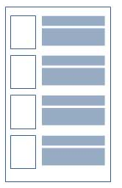
Elements of a Persona
Fictional name
Job titles and major responsibilities
Demographics such as age, education, ethnicity, and family status
The goals and tasks they are trying to complete using the site
Their physical, social, and technological environment
A quote that sums up what matters most to the persona as it relates to your site
Casual pictures representing that user group

Slide 18
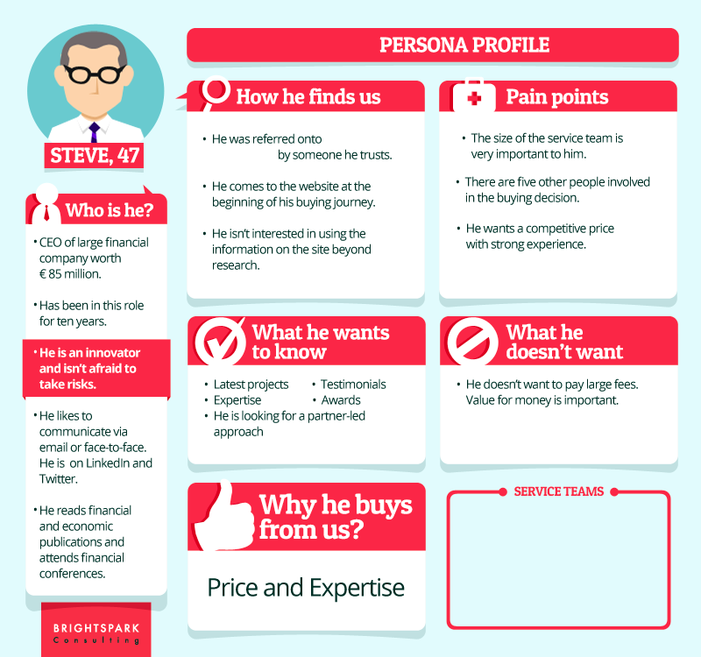

Slide 19
Small Group Activity
Create 3 to 5 personas for website or app
eBay
Amazon
Facebook
Pinterest
Snapchat
Instagram
Twitter
Yik Yak

